Slide 1
6+++++
Financial Procedures
Spring 2025
LPHA Regional Meeting
Notes:
Intro yourself and OCS
Pass out note cards
Financial Procedures (I know what you are all thinking “snooze fest” and “good think this is before lunch instead of right after”
What will we be talking about today – Yes, financial procedure updates

Slide 2
4 Questions
Who funds your grant?
What is a subrecipient?
What is the purpose of subrecipient monitoring?
What is the one thing that you wish could change in your partnership with DHSS? (can’t say need more money)
2
Notes:
Ask them the 4 questions
Anonymous and will use the answers during the presentation
Write very neatly
Don’t overthink answer and write a paragraph. A word or a sentence will do. Try not to use acronyms
Ask the questions
Afterwards collect cards
Talk about why you asked them and that at least the first 3 will be used for today’s presentation.

Slide 3
FEDERAL FUNDING FRAMEWORK
FEDERAL
AGENCY
(FUNDER)
PROCUREMENT CONTRACT
FINANCIAL ASSISTANCE AWARD
(RECIPIENT RELATIONSHIP)
COOPERATIVE
AGREEMENT
PURCHASE (CONTRACTOR/VENDOR RELATIONSHIP)
SUBAWARD (SUBRECIPIENT RELATIONSHIP)
PURCHASE (CONTRACTOR/VENDOR RELATIONSHIP)
SUBAWARD (SUBRECIPIENT RELATIONSHIP)
3
Notes:
Select 3 or 4 cards to answer question 1
Left side – not us Governed under the Federal Acquisition Regulation (Acquire property or services to carry out it’s mission as a federal agency)
Right side – Governed under the Federal Grant and Cooperative Agreement Act (Take something of value in its position and convey that thing to a non-federal partner that will encourage that non-federal partner to benefit the general public or a subset of the general public.)
Recipients – Can use the Financial Assistance Award in 2 distinct ways
contractor/vendor to purchase good/services for the program (or project); and
subrecipient as a pass-through of part of the funding award to a subrecipient partner to carry out key functions of a program
Then, a subrecipient can take the funds and spend it to carry out the contract through purchasing goods or services (including payroll of their own team members) and/or with approval of the recipient – be a pass-through entity to a new partner (2nd tier subrecipient) by the recipient and do the same.
If the s/r passes-through funding they then become a pass-through entity themselves, which imposes the same requirements as the recipient has as a pass-through entity

Slide 4
Uniform Grant Guidance
(2 CFR 200)
UGG THE PUG
4

Slide 5
Legal Framework
Federal Financial Assistance Awards
U.S. Constitution
Statutes
Congressional Authorizing Acts; Appropriation Acts;
Cross-Cutting Statues (Whistleblower Protection)
Regulations
2 CFR Part 200 (UGG); Program Specific Regulation;
Cross Cutting Regulations (45 Part 93 – Lobbying)
Guidance
Agency-wide (HHS Grants Policy Statement)
Program Specific (Policies, Manuals)
Notice of Award
Issued by the Federal funding agency to the recipient; based on application
Subrecipient Contract
Issued by the recipient (acting as a pass-through entity) to the subrecipient;
based on application
5
Notes:
Congress doesn’t give a lot of details or guidance. They could give some specifics but mostly say “here is the funds to an awarding agency for these specific purposes”

Slide 6
Subrecipient vs. Contractor
SEVERAL FEDERAL REQUIREMENTS
NOT MANY FEDERAL REQUIREMENTS
§ 200.331(a) Subrecipient Characteristics
§ 200.331(b) Contractor Characteristics
Determines eligibility;
(2) Performance measured in relation to whether program objectives were met;
(3) Responsible for programmatic decision-making;
(4) Responsible for program requirements;
(5) Uses the federal funds to carry out a program for a public purpose, as opposed to providing goods or services for the benefit of the pass-through entity.
(1) Provides the goods and services within normal business operations;
(2) Provides similar goods or services to many different purchasers;
(3) Normally operates in a competitive environment;
(4) Provides goods or services that are necessary to the operation of the federal program;
(5) Is not subject to compliance requirements of the federal program, though similar requirements may apply for other reasons.
6

Slide 7
THE TWO BROAD FUNCTIONS OF
ANY PROGRAM’S ACTIVITIES
ARE DEPENDENT ON EACH OTHER
FINANCIAL & PROGRAMMATIC
7

Slide 8
SUBRECIPIENT MONITORING
2 CFR 200.301,
Performance Measurement
200.302,
Financial Management
200.303,
Internal Controls
200.329,
Monitoring and Reporting
Program Performance
200.332,
Requirements for Pass-
through Entities
2 CFR 200.332 (e) states, “Monitor the activities of a subrecipient as necessary to ensure that the subrecipient complies with Federal statutes, regulations, and the terms and conditions of the subaward (contract).”
#1
WHY?
UNIFORM GRANT GUIDANCE SAYS WE HAVE TO!
8

Slide 9
SUBRECIPIENT MONITORING
MORE
WHYS
DHSS is a partner with Subrecipients
(joint venture)
DHSS wants citizens to have the services needed
(present & future)
9
Notes:
Monitoring is not a “GOTCHA MOMENT”
Monitoring is a way to partner with s/r

Slide 10
SUBRECIPIENT MONITORING
#1
GOAL
REASONABLE ASSURANCE
10

Slide 11
REASONABLE ASSURANCE
High, but not absolute level of assurance
Absolute assurance is not attainable due to factors such as:
Inherent limitations of internal controls
Impractical to see everything every time
Reasonable Person Standard
Someone that uses the same level of care and caution that a typical (prudent) person would in the same situation
11

Slide 12
REASONABLE ASSURANCE
CAN BE CONCLUDED BASED ON
THE WORK PERFORMED
BY THE SUBRECIPIENT
AND THE WORK
THE MONITOR DOES THROUGH
INTERVIEWS
OBSERVATIONS
REVIEWS
12

Slide 13
Important Changes to
Financial Procedures
Effective on new cost reimbursement contracts
13

Slide 14
GOALS
INCREASE AWARENESS TO
DHSS AND LPHA TEAMS
about compliance requirements for receiving and managing funds
REFINE PROCESSESS
to align business operations for successful program management
ACTIONS
DHSS HAS UPDATED
contract language, budget procedures, invoice procedures, and internal policies to ensure proper management and accountability of funds passed through to subrecipients
DHSS IS INCREASING
oversight on budgets and invoices for reimbursement
DHSS IS PRESENTING
to subrecipients and own internal program teams
14

Slide 15
THE WHY
THE UPDATES
Contract Language
Budget Template
Invoices
Policies
Subrecipient Support
Standardized Processes
Compliance
Requirements
Audit Preparedness
15

Slide 16
Contract Language
Updates to standard contract language are currently being drafted by Office of General Counsel (legal) that includes:
Specific stated requirements for reimbursable costs including that all costs must be consistent with:
Approved budget (allowing for no more than 10% of the cumulative budget deviation between budget categories) (2 CFR 200.308)
Approved project scope
Prior approval limitations (2 CFR 200.407)
Invoice submission timeframe stated in the contract
16

Slide 17
Contract Language
Requirement of an itemized budget with narrative
(2 CFR 200.302)
Attestation (2 CFR 200.415) added to invoices replacing the current Subrecipient Annual Financial Report (SAFR)
Increased use of “plain language” to clarify some requirements
Uniform Guidance changes (effective 10/1/2024)
Upcoming changes with:
OA procurement language
implementing MOvers system
17

Slide 18
Contract Language
18
Specific stated requirements for reimbursable costs including that all costs must be consistent with:
Federal funding source’s regulations
Uniform Guidance Subpart E – Cost Principles
(2 CFR 200.400 – 200.476)
THIS LEADS TO HIGHER LEVEL OF REASONABLE ASSURANCE
(200.401) “The recipient and subrecipient must apply these principles in determining allowable costs under Federal awards.”
Basic Considerations (200.402 – 200.411), including that all costs for reimbursement must be allowable (including but not limited to being reasonable, allocable, and necessary in accomplishing the deliverables of the contract).
Direct and Indirect Costs (200.412 – 200.415)
Special Considerations for States and Local Governments
(200.416 – 200.419)
General Provisions for Selected Items of Cost (200.420 – 200.476)

Slide 19
Budget with Narrative
For cost reimbursement contracts – now requiring an itemized budget by category with a narrative that is linked to and supports deliverables (e.g. personal services, supplies, travel, etc).
DHSS will provide a budget file or your agency can use a system generated budget with required information.
Provided budget file includes tabs with embedded formulas:
Instructions
Budget entry
Indirect cost calculation
Finished budget
Budget narrative
19

Slide 20
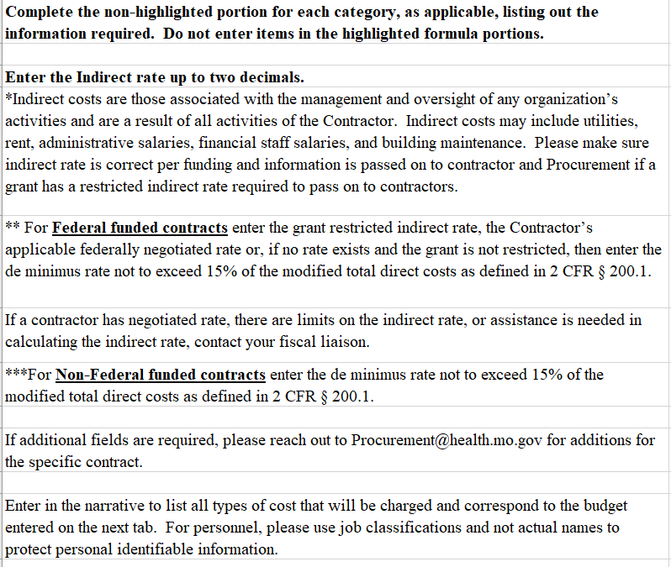
Instruction Page
20

Slide 21
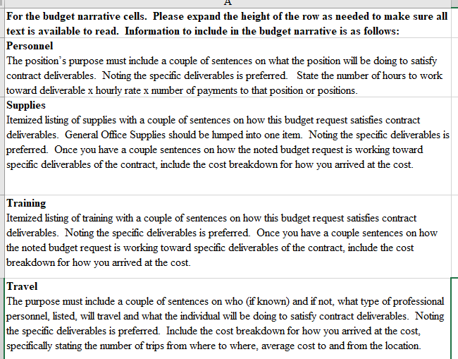
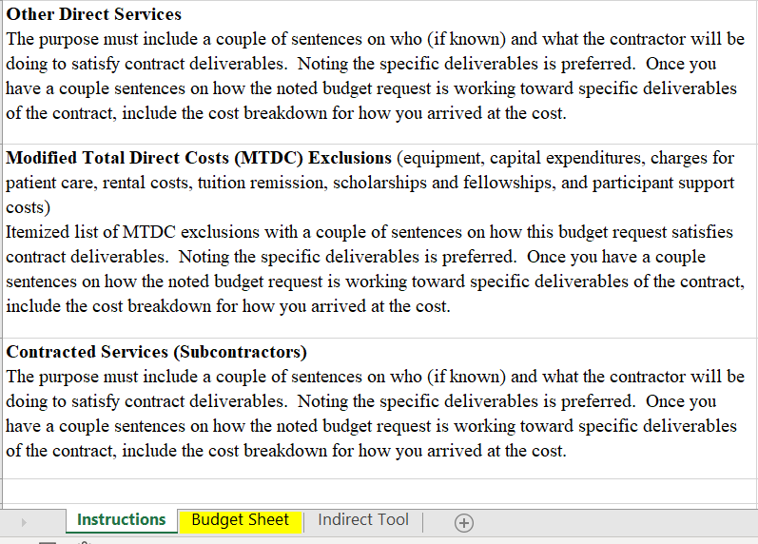
Instruction Page (continued)
21

Slide 22
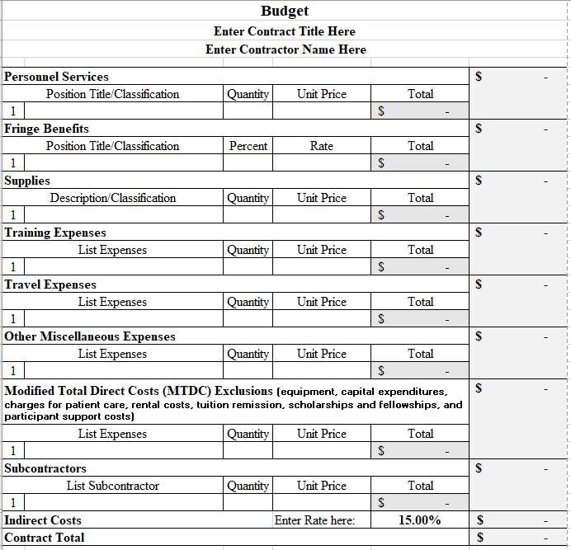
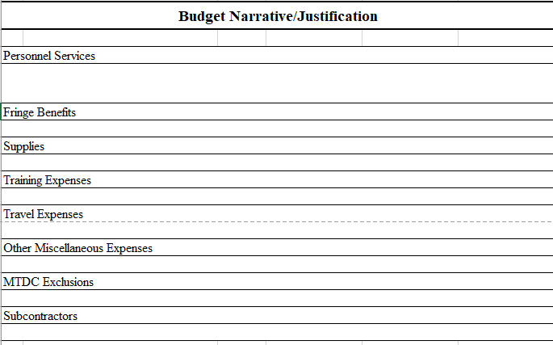
Budget Entry Tab
22

Slide 23
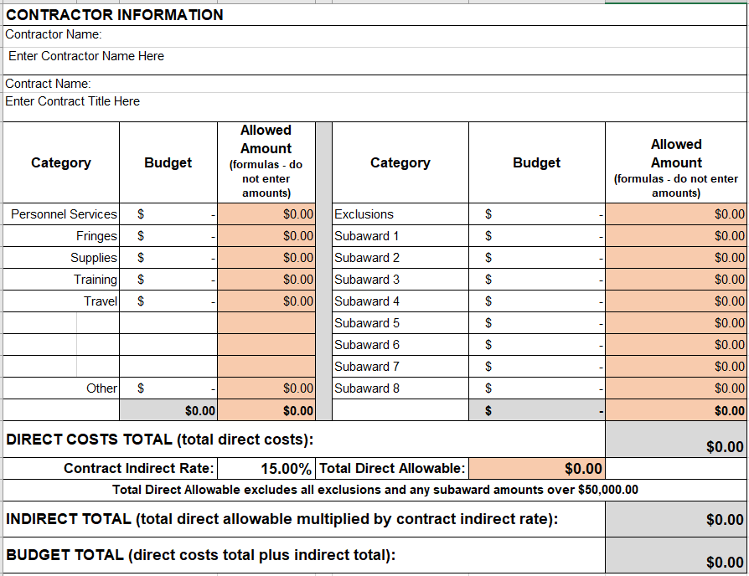
Indirect Cost Calculation Tab
23

Slide 24
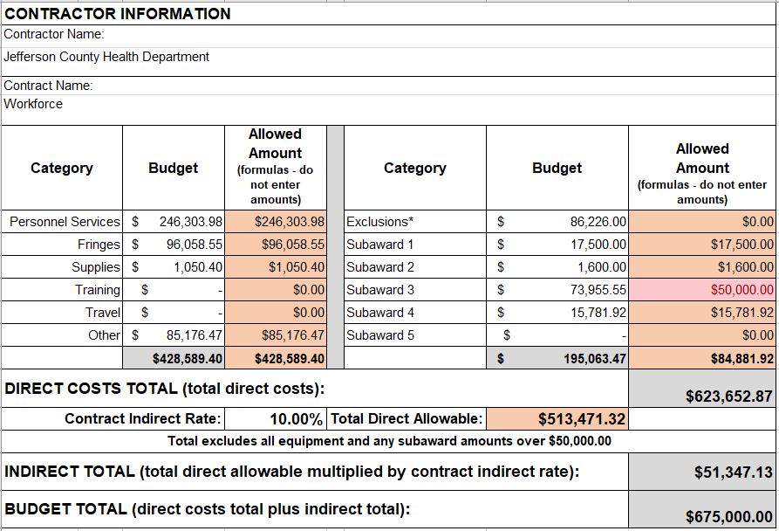
Indirect Tool Calculations
26

Slide 25
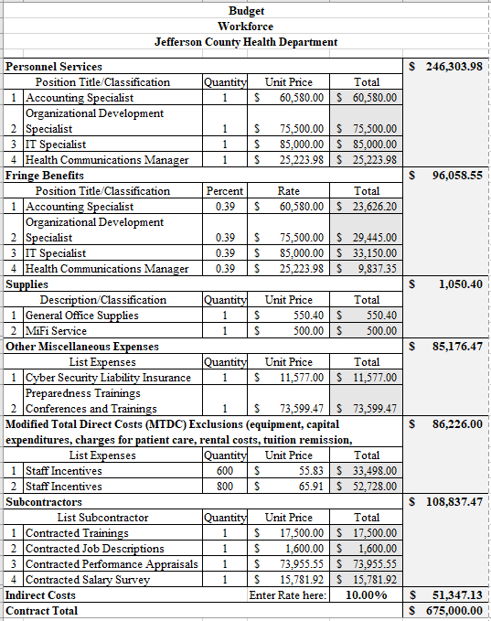
Finished Budget Tab
(w/ formulas pulling info from previous tabs)
24

Slide 26
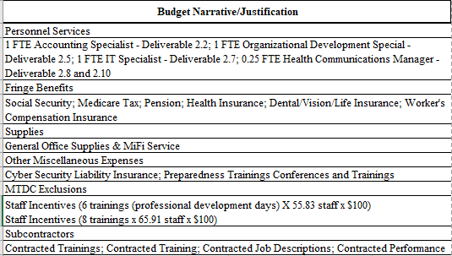
Narrative Tab Example
25

Slide 27
Invoicing
DHSS will provide an invoice file (DH-38) or your agency can use a system generated invoice with required information.
For cost reimbursement contracts – now requiring an invoice with amounts by budget category:
Time and effort description that accurately reflects work performed and is supported by a system of internal controls (2 CFR 200.430 – 200.431)
Itemized expenditure amounts by each budget category (e.g. supplies, personal service, travel, etc.)
Attestation (2 CFR 200.415) that replaces the Subrecipient Annual Financial Report (SAFR)
27

Slide 28
Invoicing
Invoice submission processes must include the signature of authorized personnel from the subrecipient after reviewing and approving for accuracy and reasonableness based on Uniform Guidance (including but not limiting to 2 CFR 200.303 and 2 CFR 200 Subpart E – Costs Principles), program regulations, and budgeted categories.
28
Notes:
Let’s walk through the new requirements:

Slide 29
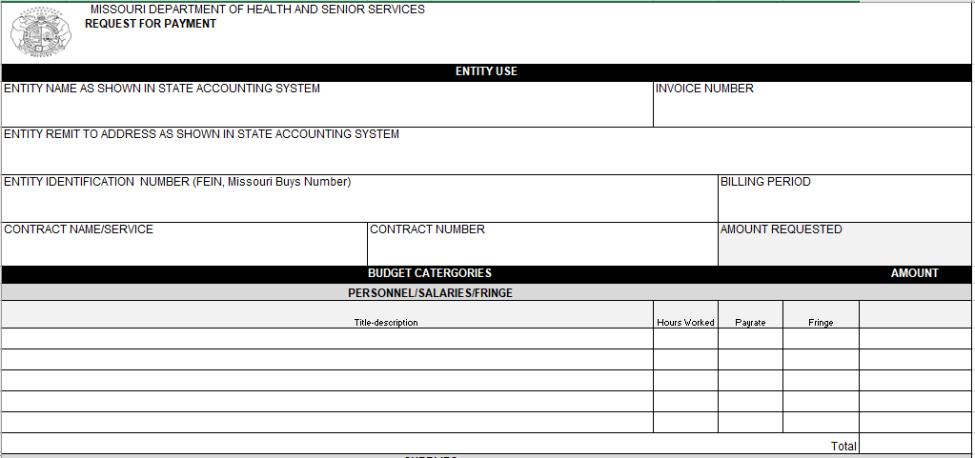
DHSS Provided Invoice Template (DH-38)
29
Notes:
The form will be broken into 2 pages and the second page will now be the coding sheet that was at the bottom of previous DH-38
The DH-38 top section will have vendor information and brief description breakdown of required itemized personnel services and have hourly rate for each position that ties to time and effort of work performed. This shows a better description of reasonableness.

Slide 30
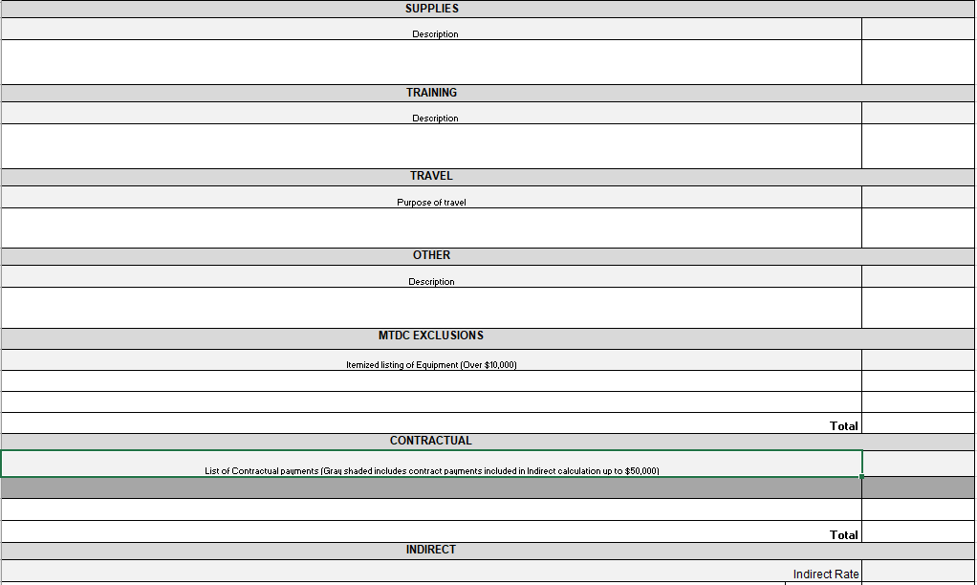
DH-38 (continued)
30
Notes:
Middle portion showing itemized expenditure for each budget category for cost tied to budget and deliverables

Slide 31
DH-38 (continued)
31

Slide 32
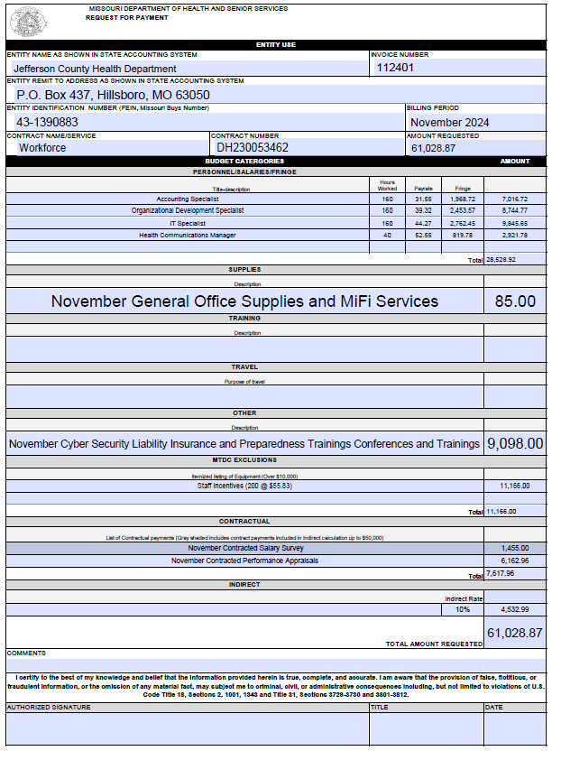
Sample Invoice
32

Slide 33
CONTACT
The best contact you have will always
be your program partner at DHSS!
Today’s presenter is:
Scott Gray, Monitoring Coordinator
DHSS – Office of Compliance Services
scott.gray@health.mo.gov

