Slide 1
Health.Mo.Gov

Slide 2
6+++++
Local Public Health Civics 101
A primer on the political nuts and bolts of Missouri’s public health system
Daniel Bogle
Health Policy Director

Slide 3
Missouri’s Public
Health System
Why are we the way we are?

Slide 4
Public Health System Structure
Federal Governance
Governmental Public Health
Healthcare, Nonprofits,
And Other Agencies
President
Congress
HHS and
Other Federal Agencies
Medical Facilities
Healthcare Professionals
State Governance
Governor
General Assembly
Insurers
Home Health
DHSS
DSS, DMH, & Other Agencies
Local Governing Body
Laboratories
Institutes/
Academia
115 LPHAs
Local Safety and Human Services
CBOs
Area Agencies
on Aging
Long-Term Care Facilities
Schools
Foundations & Associations

Slide 5
History of Missouri Public Health
1866
First local health department formed in Kansas City
1883
State Board of Health first established
1939
Missouri law authorizes county commissions to appoint county health officers
1945
Board of Health replaced by Division of Health in the
Department of Public Health and Welfare
1974
Division of Health moved to Department of Social Services
1985
Department of Health created
2001
Division of Aging transfers, creating the Department of Health and Senior Services

Slide 6
History of Public Health in Missouri
In 1939, the first law was passed giving county commissions the option to appoint a licensed physician as their county health officer (192.260, RSMo). Some counties were also allowed to appoint deputy or assistant county health officers (192.270, RSMo).
The health officer’s duty is to “enforce the rules and regulations of the department of health and senior services throughout their respective counties outside of incorporated cities which maintain a health officer.” (192.280, RSMo)
In 1945 a new law was passed that requires county commissions to appoint the director of the public health center as their county health officer (205.100, RSMo).
Because the term established in Section 192.260 is only for one year, Section 205.100 requires the appointment occur annually at the commission’s February meeting.
If there is a vacancy in the position then the director is appointed for the rest of the unexpired term, then still must be appointed at the annual February meeting.

Slide 7
LPHA Comparative Government
Why are these agencies
so different from each other?

Slide 8
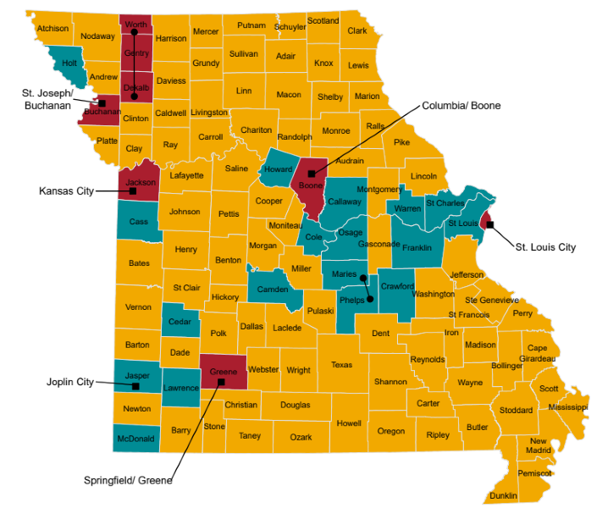
LPHAs by Governance
County Health Centers – County Board of Trustees
Independence
Health Depts / Units – Commissions or Charter
Other Forms of Governance
City or City-County Departments
Multi-County Departments

Slide 9
County Health Centers (Section 205)
Section 205 establishes the process to create County Health Centers, establish governance, and set tax levies for operations.
Voter approval for establishment of the health center and setting the maximum tax to support the county health center’s operations.
The approved tax is levied and collected by the commission and credited to the health center fund (205.020.2 & 205.042.3, RSMo).
Trustees set the annual rate of the tax levy, though it cannot exceed the maximum rate authorized by the vote of the people (205.042.8, RSMo).
County Health Centers are governed by a Board of Health Trustees
Trustees are elected, though the county governing body shall make appointments for vacancies (205.031.4, RSMo) or when not enough people file to run for trustee (205.041, RSMo). Appointees may only serve until the next municipal election.
On or before January 7th each year, the Board of Health Center Trustees shall file a report with the county commission that includes their proceedings, receipts, and expenditures during the preceding calendar year.
The Board of Health Center Trustees also must prepare and submit their budget to the county budget officer each year.

Slide 10
County Health Departments / Units
Two routes of public health authority can result in county health department systems of governance:
Non-charter first class counties create a county health department as a department of county government (205.141, RSMo)
These counties are permitted – but not required – to appoint a county health officer.
Charter counties create a public health agency via charter, who then determine agency governance by charter
St. Louis County, St. Charles County, and Jackson County
(Clay and Jefferson Counties are charter counties but established health centers through a vote of the people, not through their charters)
Alternative means of formation not explicitly specified in statute.

Slide 11
Cities and Contracts
There are two ways a city can create a health department:
Charter cities may create a city health department within their charter, making it a legal entity within their city government.
This is a power presumed under the Missouri Constitution, Article VI, Section 19.
Non-charter cities (third- and fourth-class) are authorized to enact ordinances securing health and welfare and to appoint city commissioners (Chapters 77 & 79). Third-class cities may establish a board of health to carry out ordinances.
A city health commissioner or board via ordinance only exists in Florissant.
Established by Contract:
Political subdivisions (Counties and Cities/Counties) may contract with each other to provide a common service (Chapter 70).
Missouri statute does not explicitly authorize city-county health departments, but the ability is presumed under the concept that those cities and counties already have independent legal authority to form health departments and can contract with each other for common services under Chapter 70.

Slide 12
Laws on Local Power
What exactly can we do, anyways?

Slide 13
Laws on Local Power (Sec. 192 & 205)
Both county commissions and county health center boards are authorized to make and promulgate orders, ordinances, rules, or regulations to enhance public health and prevent the entrance of diseases into the county (192.300, RSMo).
State rules and regulations supersede local rules and regulations (192.290, RSMo).
They therefore cannot conflict with DHSS rules and regulations (192.300, RSMo).
Cannot impose standards on agricultural operations that are inconsistent with, in addition to, different from, or more stringent than Missouri law (192.300.1(2), RSMo).
Both county commissions and county health center boards can establish fees to pay for costs of local health orders, ordinances, rules, or regulations (192.300.2, RSMo).
So long as those fees don’t deny personal health services to those unable to pay or impede the prevention or control of communicable disease.
Fees are deposited into the county treasury and shall be used to support the public health activities for which they were generated.
Any local orders, ordinances, rules, or regulations must be printed and available for distribution to the public in the office of the county clerk (and must be published in a newspaper in the county for three successive weeks).

Slide 14
Shannon Robinson, et al., v. DHSS
2021 Cole County judicial decision that speaks to DHSS and local agency authority.
Technically the decision is no longer valid, but some key takeaways still hold true.
BIG TAKEAWAY: LPHA authority must be specifically granted in law, either in statute or through a local ordinance where authority is authorized.
BUT there is a difference between the delegation of tasks/services and the delegation of authority.
Much of the public health authority granted in state statute is given to DHSS, such as the authority to determine the prevalence of infectious, contagious, communicable, or dangerous diseases…
… but that work would be impossible without LPHAs.
Practical tip for taking a specific action: Find the enabling statute and then any additional rule or ordinance the statute may require.
Reference Section 192.300, RSMo

Slide 15
Restrictions on Emergency Orders
In 2021, Missouri enacted Section 67.265, RSMo, restricting certain emergency orders by a health officer, LPHA, public health authority, or a political subdivision’s executive.
If an order is issued relating to an emergency declared under Chapter 44, RSMo, that closes or restricts access to businesses, churches, schools, or other places of public or private gathering or assembly:
The order cannot be in effect for longer than 30 days within a 180-day period unless authorized by a simple majority vote of the political subdivision’s governing body to extend the order or approve a similar order.
If an order of “general applicability” is issued when there is not an emergency, and it closes businesses, churches, schools, or other places of public or private gathering or assembly:
The order cannot be in effect for longer than 21 days within a 180-day period, unless authorized by a 2/3 majority of the political subdivision’s governing body.
Regardless of an emergency, the governing body of the political subdivision always has the power to terminate an order with a simple majority vote.

Slide 16
Ethics of Public
Administration
Do I need to write this down?

Slide 17
Framework for Ethics in Organizations
Values & ethics exist on the personal and organizational level.
Macro (profession/sector-wide), meso (organizational), micro (individual).
Organizational ethics are the values that guide the behavior and decision-making within an organization.
Ethical behavior is a bidirectional interaction:
Individual ethics inform organizational behavior, and organizational values and culture guide individual behavior.
External cultural norms and societal values, laws and regulations, and pressure from stakeholders.
Organizational structure and leadership creates the environment for ethical behavior.
Individual moral formation (micro) and ethical organizational structures (meso) are both needed to build an ethical organization.
Forces shaping ethical behavior: Leader’s example, organizational policies, organizational culture, and individual characteristics (Bowman & West, 2015)

Slide 18
Compliance + Integrity Framework
Compliance Strategy | Compliance + Integrity Strategy
Ethos: Conformity with external standards | Ethos: Self-governance according to chosen standards
Objective: Prevent criminal conduct | Objective: Enable responsible conduct
Leadership: Lawyer-driven | Leadership: Management-driven
Methods: Training, limited discretion, controls, penalties | Methods: Education, leadership, accountability
Behavior: Driven by material self-interest | Behavior: Guided by humanistic ideals
Adapted from Paine (1994)

Slide 19
Ethics of Public Health & Administration
APHA Code of Ethics
Professionalism and Trust
Health and Safety
Health Justice and Equity
Interdependence and Solidarity
Human Rights and Civil Liberties
Inclusivity and Engagement
ASPA Code of Ethics
Advance the Public Interest
Uphold the Constitution and the Law
Promote democratic participation
Strengthen social equity
Fully inform and advise
Demonstrate personal integrity
Promote ethical organizations
Advance professional excellence
DHSS Values
Excellence
Collaboration
Access
Integrity
Accountability

Slide 20
Implementing Ethics in Organizations
Tangible actions to integrate ethics into government (including public health!):
Write down your own organizational code of ethics and discuss them with employees.
Written policies and procedures to ensure consistent and fair treatment of employees AND constituencies.
Procedures that hold individuals and the organization accountable for conduct (supported by clear reporting of activities and accomplishments).
Assessing the efficacy of policies, programs, and services.
Encourage open expression of views by staff members and provide administrative channels for dissent.
Assure due process and safeguards against reprisal (whistleblowing and otherwise).
Promote competence and professionalism in the selection and promotion of employees and protect against biased, arbitrary, and capricious actions.
Increase representativeness of public workforce.
Some points derived from “IMPLEMENTING THE ASPA CODE OF ETHICS: Workbook and Assessment Guide”

Slide 21
Written Administrative Policies
The case for why written administrative policies are important and useful.
Administrative policies provide the baseline assumptions for how employees and constituencies are treated.
Responsibility as a governmental entity to be fair and consistent.
A standard process that reduces room for inconsistent or capricious treatment.
Provides accountability and transparency for how decisions will be made.
Helps create stability amidst leadership and staff turnover.
Writing policies that align with federal and state laws can aid in compliance.
There is, of course, the legal aspect:
Adherence to a policy can guard you/your organization from scrutiny…
…but not if it’s a bad policy or you didn’t follow the policy.
The initial act of writing down policies can help you improve processes.
Verbalizing what you do can reveal the strengths and weaknesses of your work.
FLIP SIDE: if you have written policies already, make sure they are reassessed.
ULTIMATELY: Written policies protect the public good and your organization.

Slide 22
Stewardship of Resources
Stewardship of public resources isn’t just a political talking point or jab (“My taxpayer dollars pay for your salary!”), it is a genuine ethical standard of public service.
Elected officials and the public deserve to know that public resources are being used prudently, efficiently, and effectively.
Three practical components of stewardship:
Reporting and accountability of individual activities and accomplishments.
Evaluation of programmatic and organizational processes and outcomes.
Ex. QI, policy evaluation, strategic planning/SHA/SHIP, accreditation.
QI frameworks provide tools for evaluating, improving, and reporting on impacts.
Compliance and monitoring for federal, state, and local uses of funds.

Slide 23
QUESTIONS?
Daniel.Bogle@health.mo.gov
(573) 522-2843
Health.Mo.Gov

Slide 24
References
Bowman, James S., and Jonathan P. West. Public Service Ethics. CQ Press, 2015.
"IMPLEMENTING THE ASPA CODE OF ETHICS: Workbook and Assessment Guide", ASPA, 22 Nov. 2015, www.aspanet.org/Common/Uploaded%20files/ASPADocs/Resources/Ethics_Assessment_Guide.pdf
"Local Public Health Agencies by Governance.“, Missouri Department of Health and Senior Services, www.health.mo.gov/living/lpha/pdf/ColorMapLPHA.pdf
"Missouri Public Health Authority Toolkit.", Missouri Public Health Institute, May 2024,
www.mophi.org/wp-content/uploads/2025/03/Missouri-Public-Health-Authority-Toolkit-1.pdf
Paine, L. (1994). Managing for organizational integrity. Harvard Business Review, 72, 106-117. https://hbr.org/1994/03/managing-for-organizational-integrity
"Public Health Code of Ethics.", APHA,
www.apha.org/-/media/files/pdf/membergroups/ethics/code_of_ethics.ashx

Slide 25
PROMOTING HEALTH AND SAFETY

