Slide 1
2025 Missouri MCH Needs Assessment
Health.Mo.Gov

Slide 2
Maternal, Child & Family Health

Slide 3
Title V MCH Services Block Grant
https://www.youtube.com/watch?v=DMvDHW6XG3c

Slide 4
Frameworks for Addressing the Needs of MCH Populations
Life Course Perspective
Trauma-Informed Approach
Social Drivers of Health
The life course perspective recognizes the opportunity to prevent and control diseases at key stages of life and acknowledges social and economic risk factors.
A trauma-informed and responsive program, organization or system realizes the widespread impact of trauma; understands potential paths for recovery; recognizes the signs and symptoms of trauma; and integrates trauma responsiveness into policies, procedures and practices.
Social Drivers of Health are conditions in the environment where people are born, live, work, play, worship, and age that affect a wide range of health, functioning and quality of life outcomes and risks.
“Community-level factors”

Slide 5
MCH Population Domains
Women/Maternal Health
Women of Childbearing Age – Ages 15 to 49 years old
Perinatal/Infant Health
Infants – Babies less than 1 year old
Child Health
Children – Ages 1 to 19 years old
Adolescent Health
Adolescents – Ages 13 to 19 years old
Children and Youth With Special Health Care Needs (CYSHCN)
Ages 0 to 21 years old
Children with an increased risk for chronic physical, developmental, behavioral or emotional health conditions and often require health care beyond what is required for children and youth generally.
Includes a wide variety of conditions, such as asthma, sickle cell disease, epilepsy, anxiety, autism and learning disabilities.
Family

Slide 6
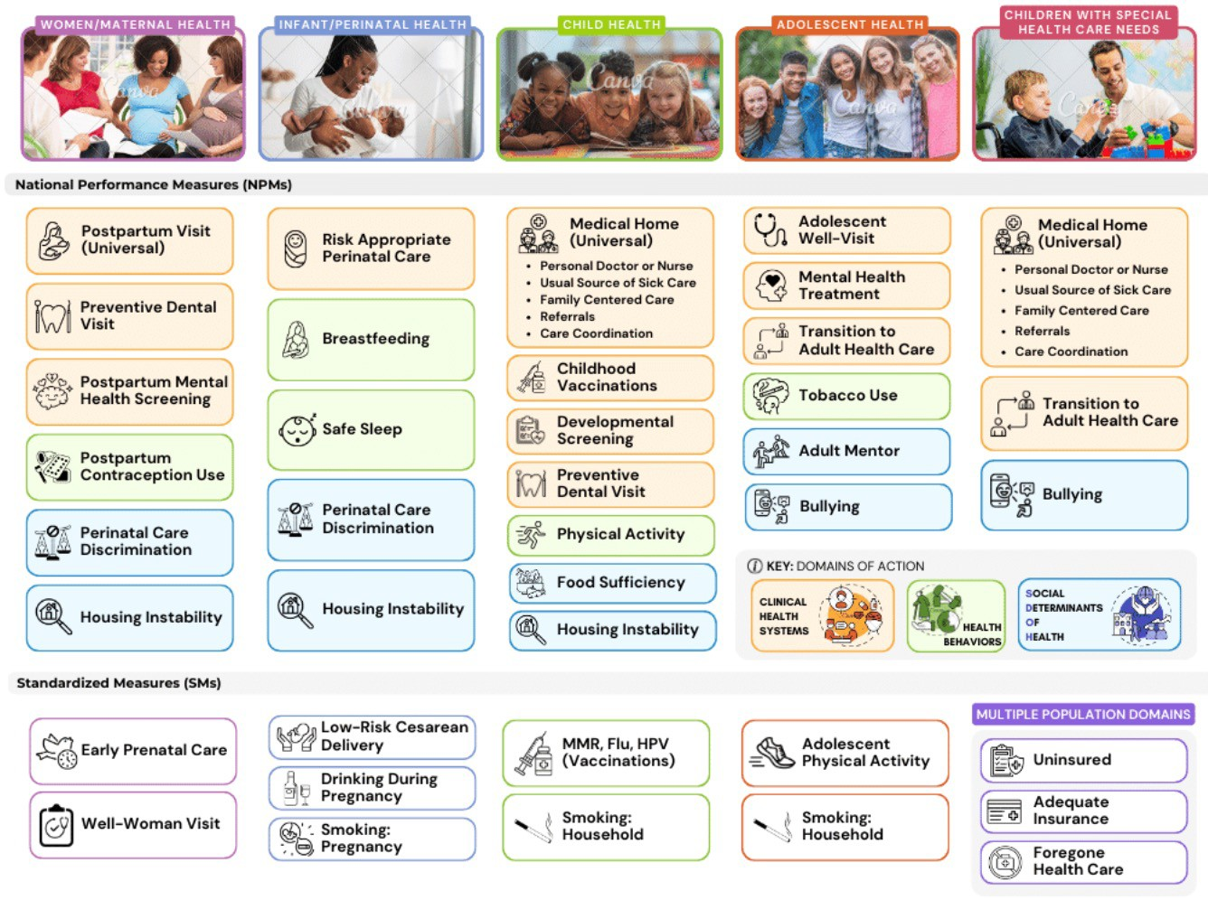
The New MCH Performance Measures

Slide 7
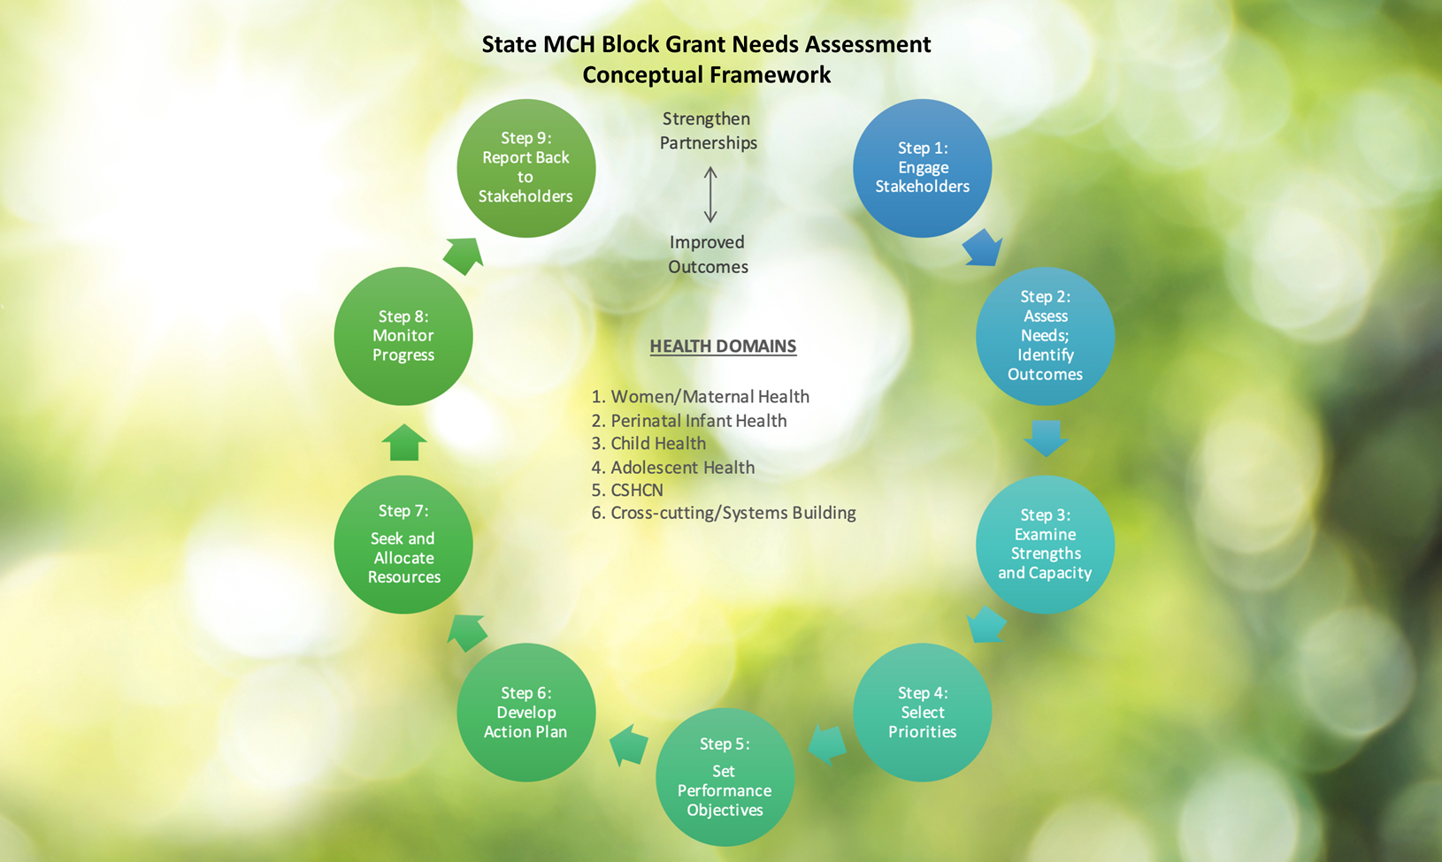
Source: MCH Needs Assessment Toolkit https://www.mchneeds.net/framework.php

Slide 8
Questions?
CONNECT WITH US
Martha Smith, MSN, RN
State Director, Maternal and Child Health / State Lead, Public Health Nursing
Martha.Smith@health.mo.gov
Andrea Tray, MPH
CYSHCN Director
Andrea.Tray@health.mo.gov
Katrina Fernandez, MPH
MCH Coordinator / State Adolescent Health Leader
Katrina.Fernandez@health.mo.gov
Jada Turley-Winchester, MPH
MCH Program Associate / MCH Family Leader
Jada.TurleyWinchester@health.mo.gov

Slide 9
6+++++
LPHA Spring Regional Meeting
Venkata Garikapaty, PhD, MPH
Karen Harbert, MPH

Slide 10
Purpose of Needs Assessment
Gather information to identify the need for:
Preventive and primary care services for pregnant women, mothers and infants up to age one
Preventive and primary care services for children
Services for children with special health care needs
Cross-cutting and systems changes
The findings help develop a five-year action plan for the grant

Slide 11
Needs Assessment Process
Listening sessions were held in all geographic regions in the State and targeted diverse communities
Missouri Maternal-Child Health Survey offered to residents in English and Spanish languages
Review of Missouri MCH indicators at the county or regional level
County-level rankings of health risk
Missouri MCH stakeholders review needs assessment data and develop priorities
Public Health Surveillance Systems
MCH Stakeholder Convening
Listening Sessions
Online Survey

Slide 12
Listening Sessions

Slide 13
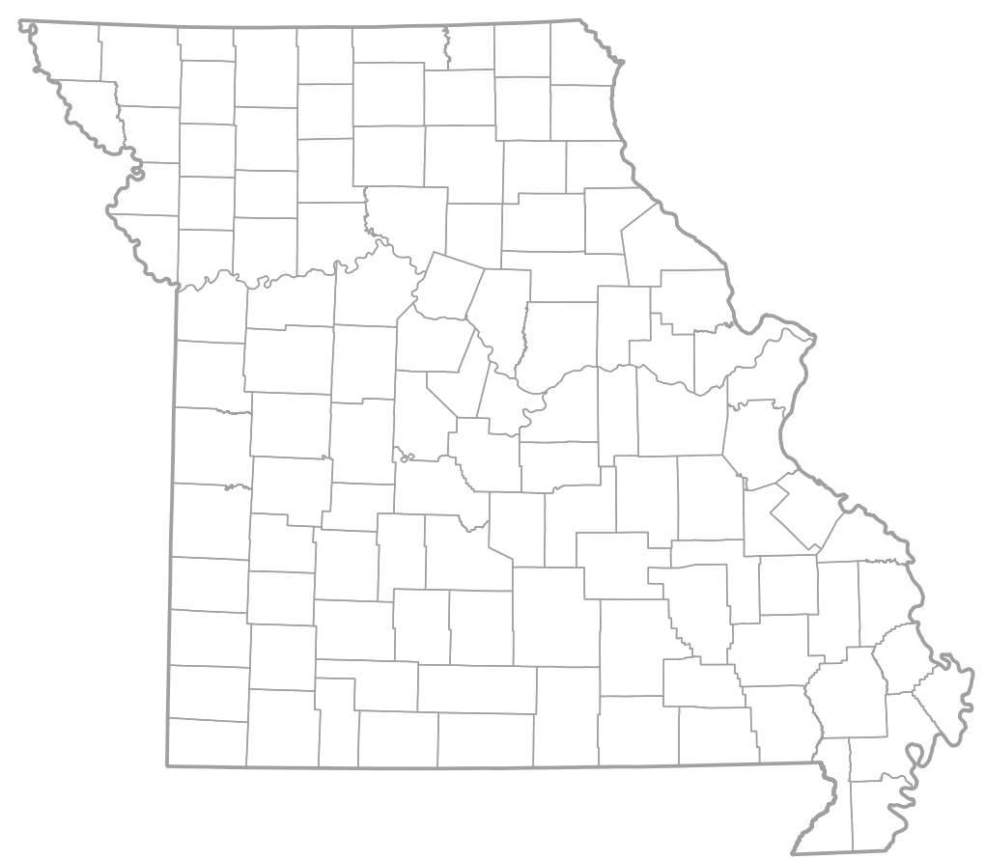
Statewide Listening Sessions
Conducted by University of Missouri - Columbia
18 sessions including some targeted to the public and others for professionals
English and Spanish
227 Missourians participated

Slide 14
Questions Asked
What are the services and programs in your community that are important for supporting maternal, child, and adolescent health?
What services and programs that support maternal, child, and adolescent health are missing in your community?
How are Children and Youth with Special Health Care Needs (CYSHCN) supported in your community? What is your experience with accessing coordinated care for CYSHCN in your community?
What do you think the local/state health department’s role or responsibility is in addressing maternal and child health issues? How should your local/state health department best provide information about maternal child health to the communities they serve?

Slide 15
Important MCH Services
WIC
Head Start/Parents as Teachers
Local County Health Department
Transportation
Food (SNAP, Free and Reduced Lunch)
Postpartum Care (Lactation Support, Home Visits, Support Groups)
Family Planning

Slide 16
Missing MCH Services
Mental Health Support
Childcare
Affordable/Accessible Services
Transportation
Community Outreach and Education

Slide 17
Mental Health Barriers
Lack of Providers
Distrust and Stigma
Cost

Slide 18
Public Survey Results

Slide 19
MCH Online Survey
Slide title
Public input from any Missouri resident about priorities for MCH
Questions included:
Demographics
Biggest barriers to accessing health care in your community
Priorities for MCH in Missouri
Participation from 111 / 115 counties
Complete Surveys
1053
Notes:
Public input from any Missouri resident that helps identify barriers they face and their opinions on priorities for MCH in Missouri

Slide 20
What do you think are the biggest barriers to accessing health care in your community?
Barriers | N (%)
Cost | 851 (81.5%)
Lack of Provider Availability | 533 (51.1%)
Couldn’t Take Time off School/Work | 531 (50.9%)
Lack of Health Insurance | 420 (40.2%)
Lack of Access to Transportation | 356 (34.1%)
Insurance Not Accepted | 294 (28.2%)
Previous Negative Experiences w/ Health Care | 251 (24.0%)
Unaware of Services Offered | 230 (22.0%)
Too Far Away | 199 (19.1%)
Immigration Status | 52 (5.0%)
Other | 34 (3.3%)
Cultural/Religious Beliefs | 22 (2.1%)
Notes:
Those were the demographic questions.
The next section asked about the biggest barriers that were faced when accessing health care in their community.
Select up to 5 options
Top 3 barriers: Cost, lack of provider availability, not being able to take time off from school/work
Provided an opportunity to write in a response that wasn’t a given option (Other)

Slide 21
Which areas do you think the Missouri Department of Health and Senior Services should focus on?
Access to behavioral and mental health care | 614 | 0.589
Access to primary care | 368 | 0.353
Dental care / oral health | 330 | 0.317
Substance use prevention and treatment (including alcohol) | 324 | 0.311
Housing instability | 268 | 0.257
Access to specialist care | 262 | 0.251
Healthy eating & active living | 235 | 0.226
Pregnancy and postpartum care | 233 | 0.224
Food security | 224 | 0.215
Women’s health | 218 | 0.209
Strengthening families | 200 | 0.192
Suicide prevention | 193 | 0.185
Transportation | 190 | 0.182
Priorities (Part 1) | N (%)
Access to behavioral and mental health care | 614 (58.9%)
Access to primary care | 368 (35.3%)
Dental care / oral health | 330 (31.7%)
Substance use prevention and treatment (including alcohol) | 324 (31.1%)
Housing instability | 268 (25.7%)
Access to specialist care | 262 (25.1%)
Healthy eating & active living | 235 (22.6%)
Pregnancy and postpartum care | 233 (22.4%)
Food security | 224 (21.5%)
Women’s health | 218 (20.9%)
Strengthening families | 200 (19.2%)
Suicide prevention | 193 (18.5%)
Transportation | 190 (18.2%)
Notes:
-Priorities, we provided a list of 24 areas and asked participants to pick 5
Top 12 of them are listed here and the other 12 are on the next slide
-Access to behavioral/mental health care
-Access to primary care
-Dental care / oral health

Slide 22
Which areas do you think the Missouri Department of Health and Senior Services should focus on?
Access to behavioral and mental health care | 614 | 0.589
Access to primary care | 368 | 0.353
Dental care / oral health | 330 | 0.317
Substance use prevention and treatment (including alcohol) | 324 | 0.311
Housing instability | 268 | 0.257
Access to specialist care | 262 | 0.251
Healthy eating & active living | 235 | 0.226
Pregnancy and postpartum care | 233 | 0.224
Food security | 224 | 0.215
Women’s health | 218 | 0.209
Strengthening families | 200 | 0.192
Suicide prevention | 193 | 0.185
Transportation | 190 | 0.182
Priorities (Part 2) | N (%)
Support for children and youth with special health care needs | 182 (17.5%)
Child development | 176 (16.9%)
Reducing health disparities | 167 (16.0%)
Adolescent health | 126 (12.1%)
Immunization | 118 (11.3%)
Domestic violence / intimate partner violence | 117 (11.2%)
Breastfeeding | 92 (8.8%)
Violence prevention | 53 (5.1%)
Tobacco prevention and cessation | 47 (4.5%)
Safe infant sleep | 46 (4.4%)
Injury prevention | 32 (3.1%)
Other | 22 (2.1%)
Notes:
Select up to 5 options

Slide 23
Quantitative Data

Slide 24
Overview of Quantitative Analysis
The needs assessment incorporated measures using different geographic units, such as census tracts, ZIP codes, and regional data.
30 measures covering a wide variety of data across maternal and child health, including cross-cutting and systems measures
County-level was the most granular unit that was widely available
Each measure was analyzed with a statistical technique of z-scores

Slide 25
Access to Data for LPHAs
Slide title
Each LPHA will receive a dataset with their local data to support development of MCH work plans
Enables LPHAs to have in-depth data analysis even if they do not have an epidemiologist on staff

Slide 26
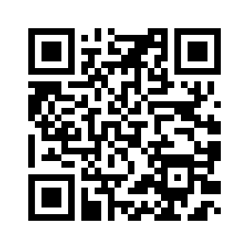
Maternal and Child Health Data Sources Webpage
https://health.mo.gov/data/mch-sources.php

Slide 27
https://healthapps.dhss.mo.gov/MoPhims/MOPHIMSHome

Slide 28
MCH Health Rankings

Slide 29
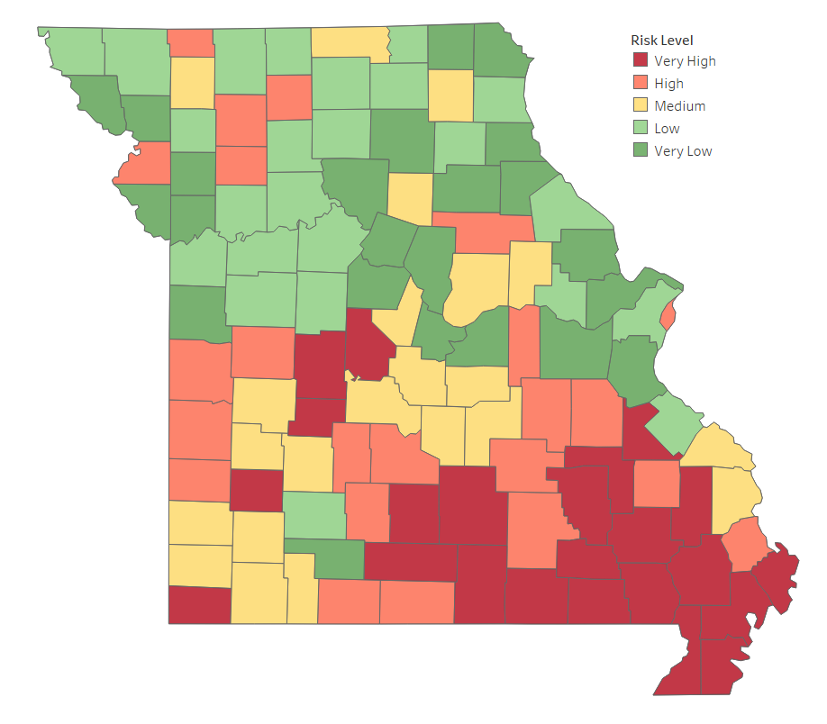
Overall County Ranking – Very Low Risk
Slide title
Andrew
Boone
Cass
Chariton
Christian
Clark
Clay
Clinton
Cole
Cooper
Franklin
Holt
Howard
Jefferson
Lincoln
Macon
Marion
Monroe
Osage
Platte
Ralls
Scotland
St. Charles

Slide 30
Overall County Ranking – Low Risk
Slide title
Adair
Atchison
Carroll
DeKalb
Greene
Harrison
Jackson
Johnson
Lafayette
Lewis
Linn
Livingston
Mercer
Nodaway
Pettis
Pike
Ray
Saline
Schuyler
Shelby
St. Louis
Ste. Genevieve
Warren

Slide 31
Overall County Ranking – Medium Risk
Slide title
Barry
Callaway
Camden
Cape Girardeau
Cedar
Gentry
Jasper
Knox
Lawrence
Maries
Miller
Moniteau
Montgomery
Newton
Perry
Phelps
Polk
Pulaski
Putnam
Randolph
St. Clair
Stone
Sullivan

Slide 32
Overall County Ranking – High Risk
Slide title
Audrain
Barton
Bates
Buchanan
Caldwell
Crawford
Dallas
Daviess
Dent
Gasconade
Grundy
Henry
Laclede
Madison
Ozark
Scott
Shannon
St. Louis City
Taney
Vernon
Washington
Webster
Worth

Slide 33
Overall County Ranking – Very High Risk
Slide title
Benton
Bollinger
Butler
Carter
Dade
Douglas
Dunklin
Hickory
Howell
Iron
McDonald
Mississippi
Morgan
New Madrid
Oregon
Pemiscot
Reynolds
Ripley
St. Francois
Stoddard
Texas
Wayne
Wright

Slide 34
Contacts for Missouri MCH Data:
Venkata Garikapaty, PhD, MPH
Assistant Deputy Director, Division of Community and Public Health
Venkata.Garikapaty@health.mo.gov
Karen Harbert, MPH
Lead Maternal-Child Health Epidemiologist
Karen.Harbert@health.mo.gov

