Slide 1
Grant Management Resources
& Key Updates
2025 LPHA Regional Meetings

Slide 2
Grant Management

Slide 3
What is grant management?
Comprehensive process of overseeing all activities related to a grant or award.
Includes all major steps of a grant lifecycle
Includes several staff.
To do this, adhere to Uniform Grant Guidance

Slide 4
Getting Started
Understand Compliance Requirements
Assessment
Develop a Compliance Strategy
Create Internal Culture and Mindset
Training
Compliance Officer
Monitor and Reporting
Continuous Improvement
Celebrate Success

Slide 5
Resources
DHSS
Other LPHAs
Grantmanship Center
Grant Writing USA
National Grant Management Association

Slide 6
Public Health Trust Poll

Slide 7
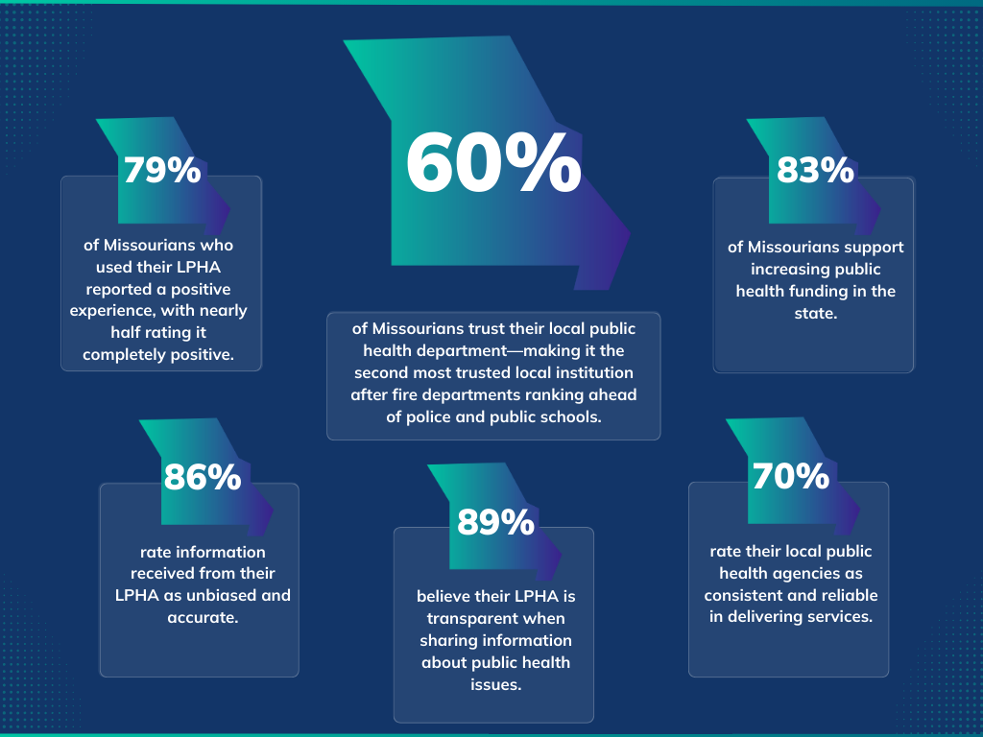

Slide 8
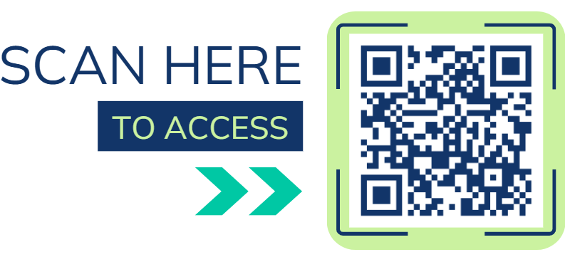
Access and Use
mophi.org/resources

Slide 9
Accreditation Assistance

Slide 10
Collaboratives and Cohorts
PHAB
MICH
PHAB Reaccreditation
CHA/CHIP Cohort
Strategic Planning Cohort – coming again soon!
  If interested contact tanderson@mophi.org
accreditation@mophi.org

Slide 11
Upcoming Trainings / Events
Writing Policies & Procedures: Best Practices for Clarity and Compliance
  May 20th from 11am -12:00pm (Tues)
  Register before
Narrative Writing Workshop
  June
Regional Accreditation Coordinator Retreats
  3 pilots in 2025
  Currently gauging interest
accreditation@mophi.org

Slide 12
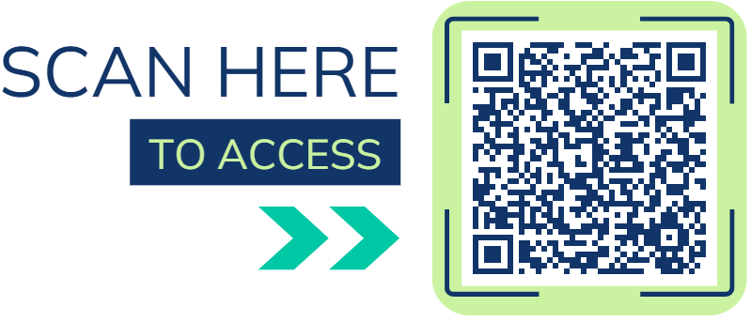
Accreditation Resource Library
accreditation@mophi.org

